Slide 1

MILESTONE 3
Distance Measurement and microphone volume control
Mentor : Dr. D. Bhanu Prakash
Presented by: MAJJI HARI KRISHNA

Slide 2

PROBLEM STATEMENT
Volume Mapping and Control Module
The gesture distance will be mapped to system volume levels from 0% to 100%.
Volume control will be executed using Pycaw or equivalent libraries (PyAutoGUI) with smooth transitions.
Output :
Hand landmarks overlayed on the video stream
Live camera feed with microphone volume control
3

Slide 3
Modules & Technologies used
OpenCV – Webcam video capture and processing
Media pipe – Hand tracking and Gesture Detection
Py Caw – Manages/Controls windows system volume through Core Audio APIs
COM interfaces – (COM initialization + COM Object activation) Manages Audio endpoints
Keyboard (Global Hotkeys) – Optional fallback volume control
3

Slide 4
Working process
Webcam capturing live video
Media pipe detects hand landmarks
Distance between fingers calculated
Gesture interpretation (Pinch – Yes/No)
Gesture/Distance mapped to volume percentage
Py caw updates microphone volume in parallel
3

Slide 5
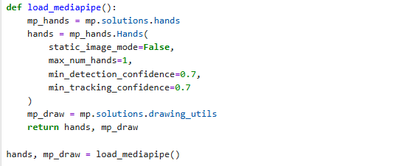
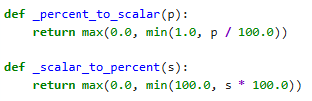
Understanding Code Snippets
_percent_to_scalar(p) and _scalar_to_percent(s)
Converts percentage volume(0-100%) Windows scalar format (0.0 – 1.0)
7

Slide 6
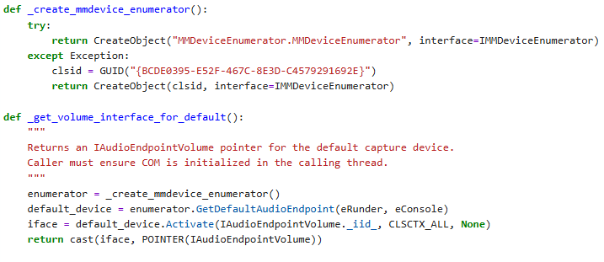
_create_mmdevice_enumerator() :
Creates an IMMDeviceEnumerator object, which is the windows Core Audio component that lists and accesses audio devices ( microphone , speakers, headsets )
_get_volume_interface_for_default() :
Gets IAudioEndpointVolume interface for the default microphone

Slide 7
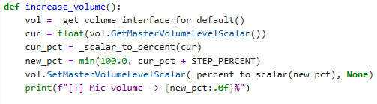
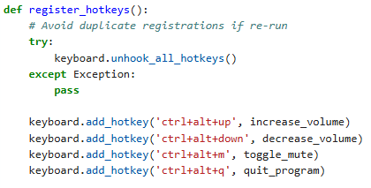
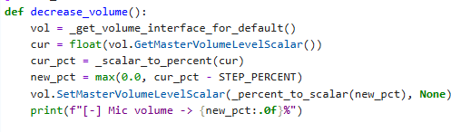
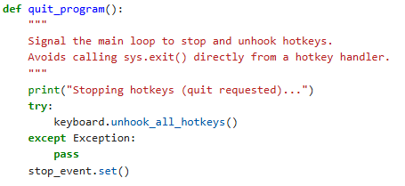
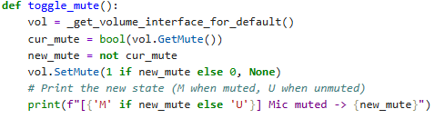

Slide 8
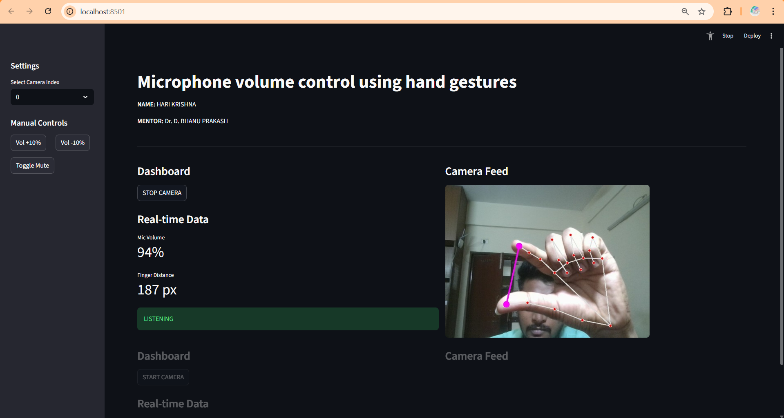
STREAMLIT APP
Interactive Web UI: Converts Python scripts into a web app, replacing basic OpenCV windows with a browser-based interface.
Real-Time Control: Uses buttons and toggles to dynamically control camera and features without restarting.
Live Dashboard: Displays real-time data with clean metrics and live-updating line charts.
State Management: Remembers app settings (like camera on/off) across updates for a smooth user experience.

Slide 9
THANK YOU

